Slide 1


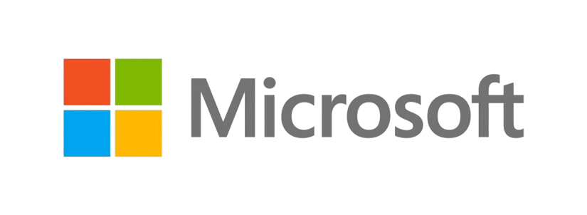


#htmdcommunity
@htmdcommunity
HTMD Community Conference - 2024

Slide 2
Thank You Sponsors!

Slide 3


Speaker
Automate Intune day to day tasks using Microsoft Graph API and PowerShell – Tips and Tricks
Sujin Nelladath

Slide 4

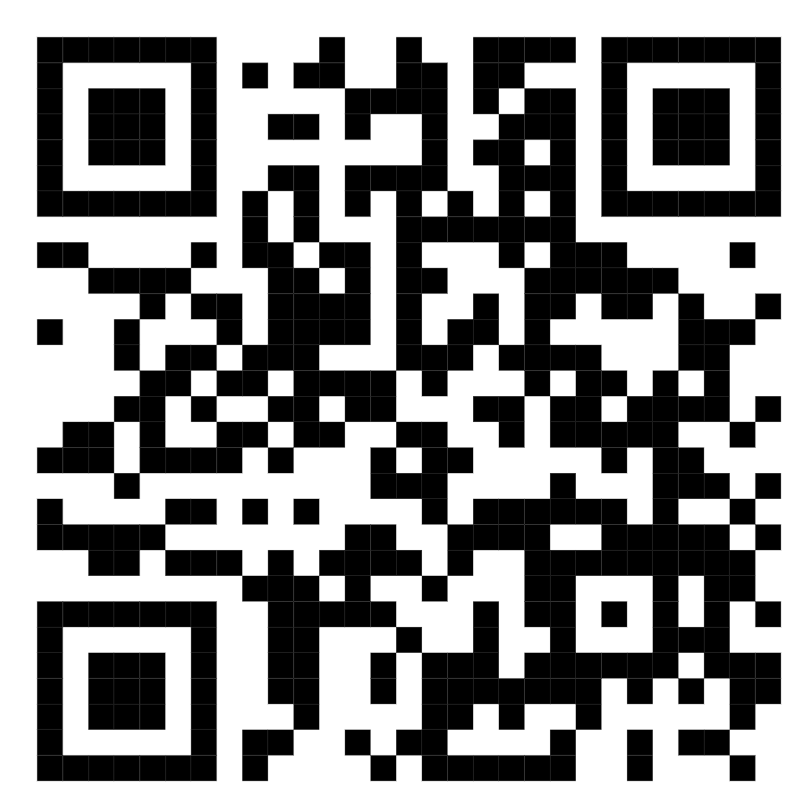
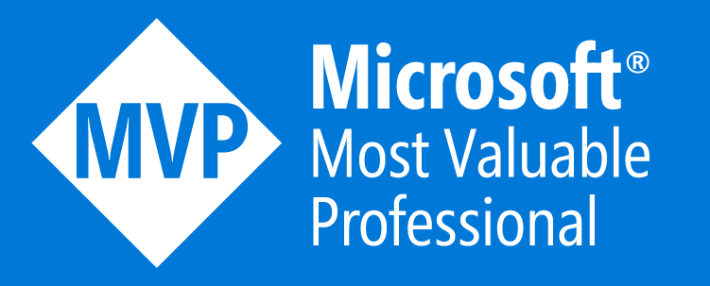
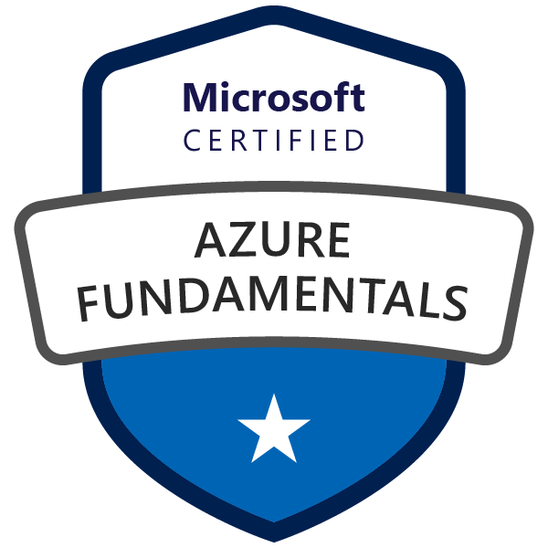

Who Am I
LinkedIn
Microsoft MVP (Microsoft Graph)
SCCM, Azure & Intune Corporate Trainer
Tech Blogger
DevOps Engineer at CSG International

Slide 5
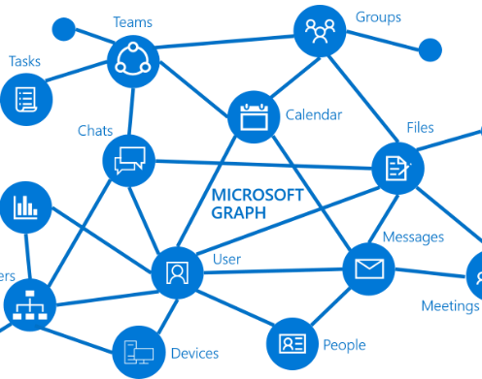
What's in Microsoft Graph?
Microsoft Graph is the gateway to data and intelligence in Microsoft 365. It exposes REST APIs and client libraries to access data on the following Microsoft cloud services:
Microsoft 365 core services
Enterprise Mobility + Security services
Windows services (activities, devices, notifications, Universal Print)
Dynamics 365 Business Central services

Slide 6
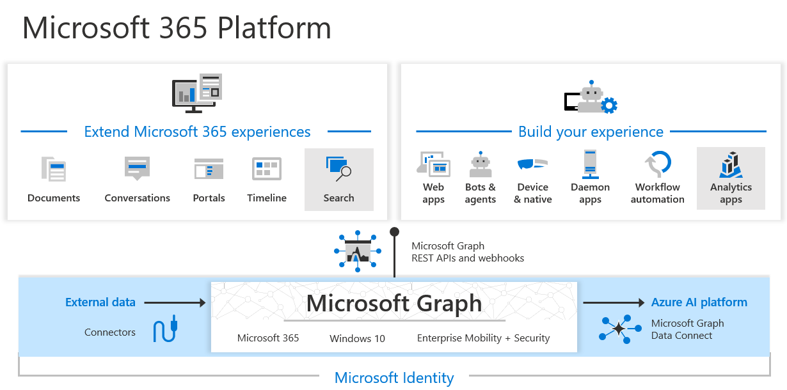
Microsoft 365 Platform

Slide 7
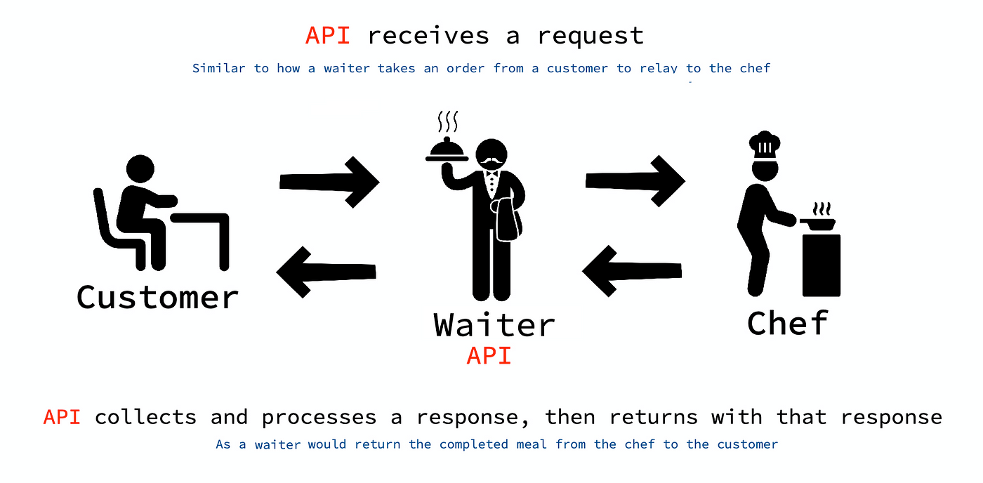
How does the API works?
Notes:
API stands for Application Programming Interface. It's a set of rules and protocols that allows software applications to communicate with each other by sending requests and responses. APIs are the messenger that delivers requests to the provider and then returns the response.

Slide 8
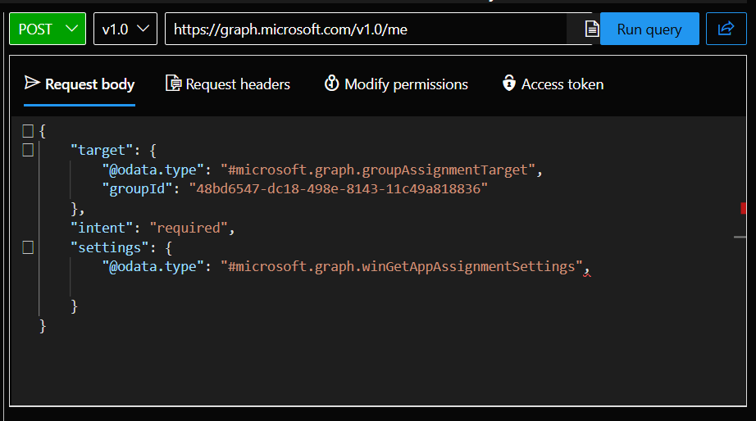
What is Microsoft Graph API
Microsoft Graph is a RESTful web API that enables you to access Microsoft Cloud service resources.
GET, POST, PATCH, PUT AND DELETE are HTTP methods available.
The POST, PATCH, and PUT methods require a request body, usually specified in JSON format, that contains additional information, such as the values for properties of the resource.
Microsoft Graph currently supports two version: v1.0 and beta.
Graph Explorer is a web-based tool that you can use to build and test requests using Microsoft Graph APIs. You can access Graph Explorer at: https://developer.microsoft.com/graph/graph-explorer

Slide 9
PowerShell - Tips and Tricks
Always open the PowerShell as an Administrator.
Install the Microsoft Graph PowerShell Modules before you start
You should have .NET Framework 4.7.2 or later installed on your machine before installing Microsoft Graph PowerShell modules.
Update PowerShellGet to the latest version using Install-Module PowerShellGet
Sign in using Connect-MgGraph command each time with the necessary permissions to automate your daily tasks
PowerShell script execution policy must be set to remote signed or less restrictive

Slide 10
Common Intune Tasks to Automate
Device management
Intune Policy Creation
Policy Deployment
Applications Management
Report Management
Software Updates
User Creation
Creating device groups and many more..!

Slide 11
Let us see it in action!!!
Step-by-step walkthrough of automating few Intune tasks
Code snippets and explanations

Slide 12

Feedback

Slide 13

Thank you
@managedevices
#HTMDConf2021

